Slide 1
Dweb Lecture 9
ANVA

Slide 2
Today
chapter 9 “Learning jQuery” 4rd edition:
jQuery: work with tables
jQuery selectors VS traversal methods (page 241)
Task1
custom pseudo-class (plugins)
Task2
jQuery’s DOM element stack

Slide 3
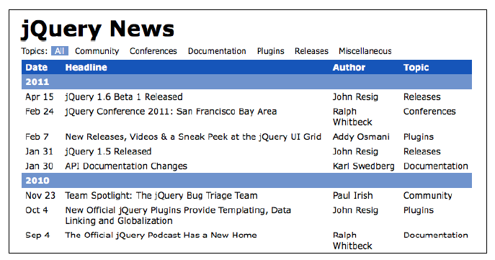
Chapter 9
2 minutes
chapter 9 Learning jQuery 4rd edition:
Use a couple of minutes to familiarize yourself with the table in file 01_[book]chpt09/index.html

Slide 4
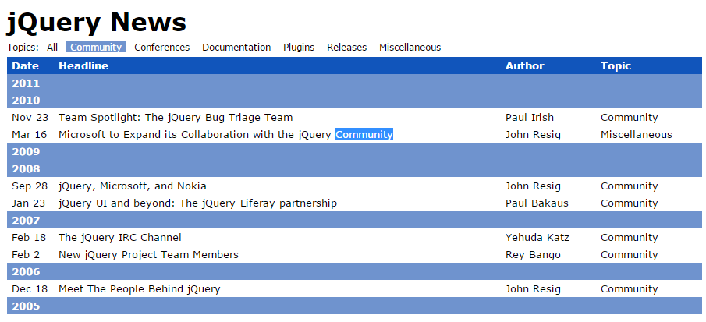
Advanced Selectors and Traversing
Selecting rows and columns in various ways
Filter a table dynamically: (from page 243)
Based on a topic (selected by user)...
hide all rows that do not contain the selected topic -> listing 9.2 p. 244
instead of the selector :not consider the method .not()
wrong :(

Slide 5
Advanced Selectors and Traversing
Filter a table dynamically: (from page 243)
...
.not() is like .filter() : also not can take an anonymous function as parameter -> listing 9.3 p. 245
$('#news tr:has(td):not(:contains("' + topic + '"))') .hide();
VS
$('#news').find('tr:has(td)').not(function() {
return $(this).children(':nth-child(4)').text() == topic;
}).hide();
The second takes care of topic that happens to appear as part of a news headline This new code eliminates some of the complex selector expression text by adding DOM traversal methods.
Notes:
What type of data is returned by anonimous function passed to .not?

Slide 6
Task1
Change the code in listing 9.3.js so that it prints (using console.log) the headlines and the author of all the selected news.
$('#news').find('tr:has(td)').not(function() {
return $(this).children(':nth-child(4)').text() == topic;
}).hide();
5 minutes

Slide 7
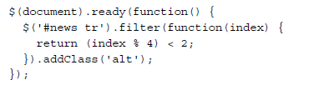
Table row striping
:nth-child(4) -> a pseudo-class
:nth-child(even) -> replacement for :even custom selector
Problem: how to stripe the table 2 by 2 ?
use filter instead -> listing 9.5 page 247
where does index come from?
modulus operator % -> Z_{n}
-> see img page 246
-> listing 9.4
index index%4
0 0 <2 => T
1 1 <2 => T
2 2 <2 => F 3 3 <2 => F 4 0 <2 => T
5 1 <2 => T …
Notes:
Try this line: for (var i=0;i<10;i++){ console.log( i , i % 4); }

Slide 8
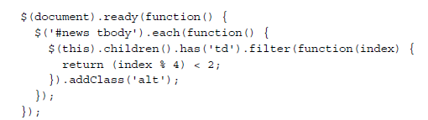
A couple of loose ends
Need to clean up:
no longer using :nth-child() -> the alternation does not begin again within each <tbody>
also: we should be skipping table header rows
-> listing 9.6 page 274
result: a more continous striping across the page -> see img page 248

Slide 9
Disappearing rows
When a particular topic is selected, many rows of the table disappear -> it makes the striping look silly
solution: when topic is selected, force a re-striping
-> listing 9.7 page 248-249
Use a function to put the code we want to re-use (for striping)
Advantages:
cleaner code,
reusable,
programmer-defined operations (like function stripe() )

Slide 10


Slide 11
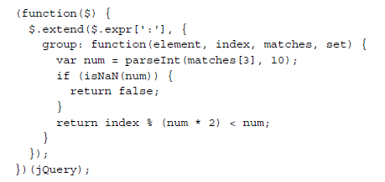
Writing a custom selector plugin
One way to improve legibility is to encapsulate code snippets in reusable components -> by creating functions (as we just did)
Another approach is to define plugins
easiest type of selector expression we can add is a pseudo-class (i.e. expressions that start with a colon) -> like :nth-child()
example: a custom pseudo-class called :group() -> page 250
Use group like this: $(‘tr’).filter( ‘:group(2)’ ).addClass(‘alt’);
Notes:
What type of data is returned by the group function?
Or: what type of data is required by the filter function to work?

Slide 12
The four parameters
The function is passed four parameters:
element: The DOM element under consideration.
index: The index of the DOM element within the result set.
matches: An array containing the result of the regular expression that was used to parse this selector. Typically, matches[3] is the only relevant item in the array; in a selector of the form :a(b), the matches[3] item contains b, the text within the parentheses.
set: The entire set of DOM elements matched up to this point. This parameter is rarely used.
:group( 4 )

Slide 13
Task 2: OK, but what does it do??
Example: $(‘tr’).filter( ‘:group(2)’ ).addClass(‘alt’);
Change the code in 9.9.js to test the following:
what is the effect of :group(2) ?
and what does :group(5) do?
Notes:
What is the effect of filter in the first line of the page?

Slide 14
Let’s test :group()
Look at 01b plugins/group.html
Example num = 2
index index%(num*2)
0 0 <num => T
1 1 <num => T
2 2 <num => F 3 3 <num => F 4 0 <num => T
5 1 <num => T 6 2 <num => F 7 3 <num => F
…
Example num = 3
index index%(num*2)
0 0 <num => T
1 1 <num => T
2 2 <num => T 3 3 <num => F 4 4 <num => F
5 5 <num => F 6 0 <num => T 7 1 <num => T
…

Slide 15
Performance
Page 252 and on.
Risk: premature optimization and micro-optimization -> spending hours tweaking code to shave milliseconds off of their JavaScript execution times when:
there was no noticeable performance lag in the first place
and the performance boost is barely perceptible
Difficult to assess performance:
better use benchmarking sites like http://jsperf.com/
example: http://www.breck-mckye.com/blog/2014/08/using-jsperf-a-how-to-guide/
… and a demo here: https://jsperf.com/rm-demo

Slide 16


Slide 17

Traversal methods and DOM element stack
page 256
selectors
$(‘ ... ’) VS .next() .parent() and .find() .not() .filter()
When using traversing methods jQuery keeps track of our path through the DOM! (from listing 9.12 )
Record-keeping:
jQuery objects are create when methods are applied to $()
each jQuery object instance has a .prevObject property pointing to the previous one -> AKA the DOM element stack
?
See: page 258
Notes:
Old versions of jQuery => addSelf
Deprecated, so now it is called: addBack
From: listing 9.12
“.nextAll()
Get all following siblings of each element in the set of matched elements…”

Slide 18
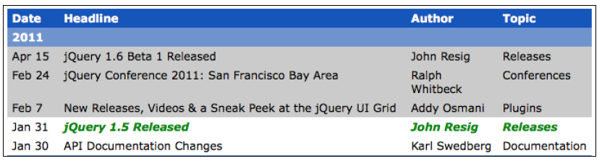
result:
.addBack() -> jQuery looks back one step on the stack, and combines the two element sets
Here it means that the highlighted cells include both the two cells found by the .nextAll() call and the original cell
NOTE: the new, merged element set is then pushed onto the stack (so we could keep performing more operations on the set!)
Notes:
“.addBack()
Add the previous set of elements on the stack to the current set…”

Slide 19
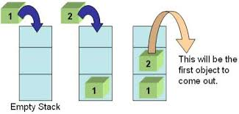
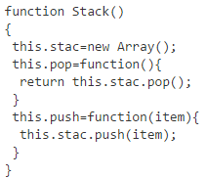
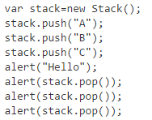
Stack
A nice example:
http://www.i-programmer.info/programming/javascript/1674-javascript-data-structures-stacks-queues-and-deques.html
See folder 01c_stack

Slide 20
Next lecture
Localstorage + JSON: read
https://www.w3schools.com/html/html5_webstorage.asp
http://stackoverflow.com/questions/2010892/storing-objects-in-html5-localstorage
how to create an editor (that remembers)
A bit more about assertions: read
[ELO] http://eloquentjavascript.net/08_error.html section “Assertions”
General discussion of assertions: https://en.wikipedia.org/wiki/Assertion_(software_development)

Slide 21
Fac-simili exam set
Let’s work on it for 2 hours

